Slide 1
The New Modern Application Platform Session 5: Kubernetes Session 2
“Bridging the growing chasm between developers and infra engineering”
Ellis Paul
Senior TAM
April 2021

Slide 2
Today’s Class
Sidecars
ConfigMaps and Secrets
RBAC
Persistent Disks and CSI
Resource requests and limits
Horizontal Autoscaler
CRDs
Node operations

Slide 3
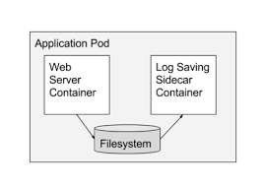
Sidecars
Special purpose utility containers to abstract common functionality
A sidecar is a utility container in a pod that’s loosely coupled to the main application container
Remember: a pod is a group of one or more containers with shared storage and network
Each container is on its own port (shared IP for pod)
Examples of a sidecars in common use are ServiceMesh and Telegraf
Notes:
https://kubernetes.io/docs/concepts/workloads/pods/

Slide 4
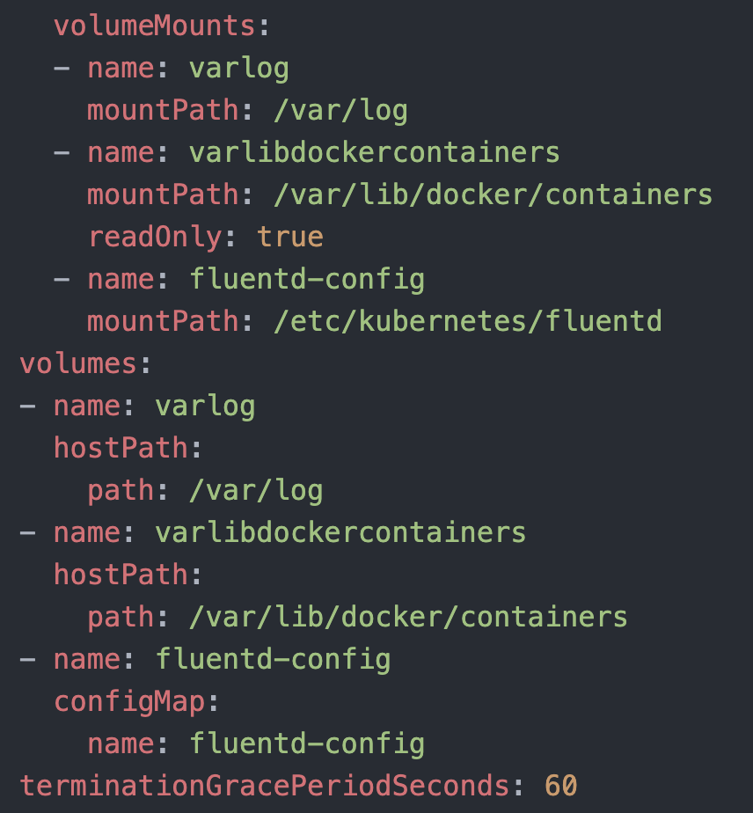











ConfigMaps
Use a ConfigMap for setting configuration
data separately from application code.
A ConfigMap is an API object used to store non-confidential data in key-value pairs
A ConfigMap allows you to decouple environment-specific configuration from your container images, so that your applications are easily portable
ConfigMap does not provide secrecy or encryption – see Secrets
Pods can consume ConfigMaps as environment variables, command-line arguments, or as configuration files in a volume.
Notes:
https://kubernetes.io/docs/concepts/configuration/configmap/

Slide 5
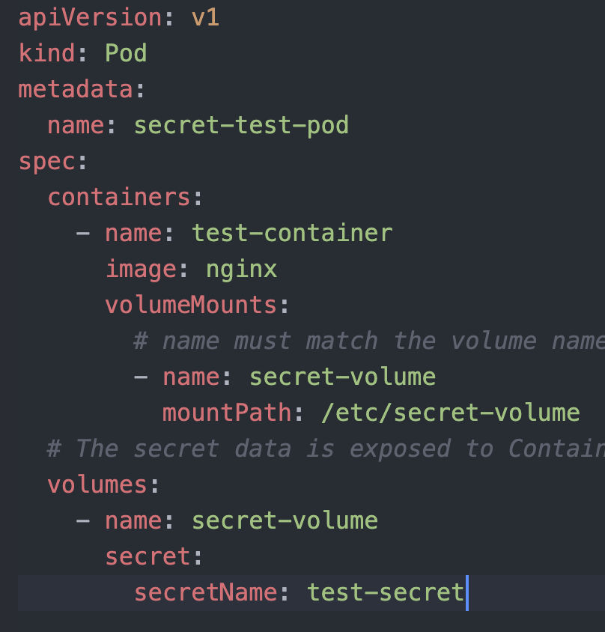
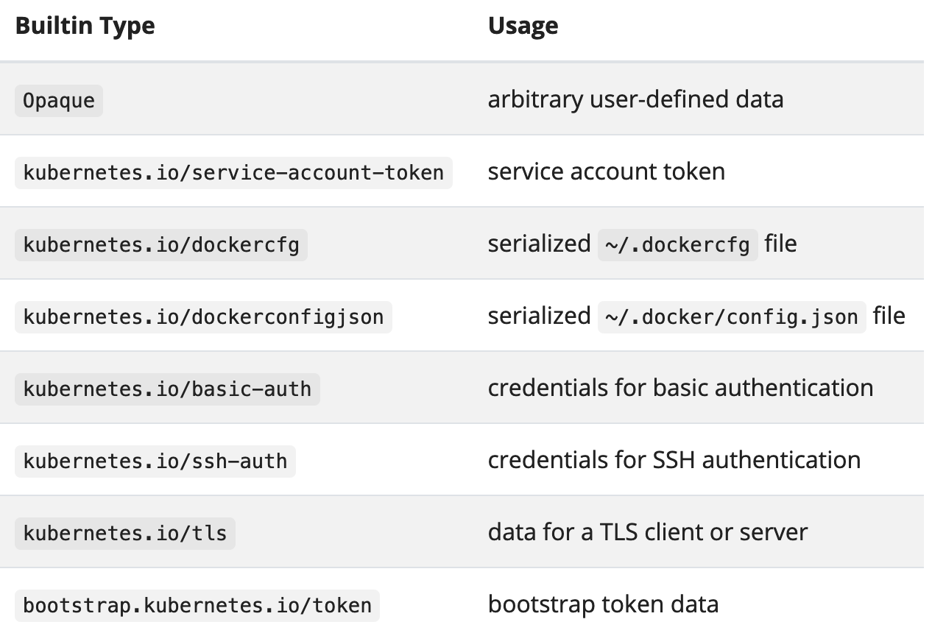











Secrets
Used to store confidential info
Kubernetes Secrets let you store and manage sensitive information, such as passwords, OAuth tokens, and ssh keys
Notes:
https://kubernetes.io/docs/concepts/configuration/secret/
https://kubernetes.io/docs/tasks/inject-data-application/distribute-credentials-secure/

Slide 6
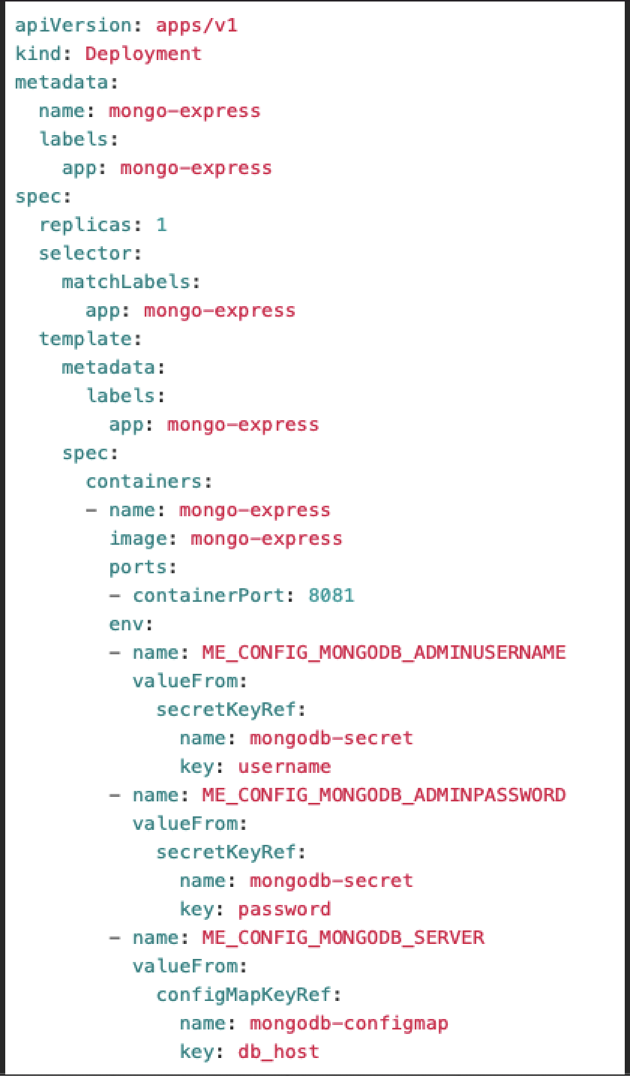
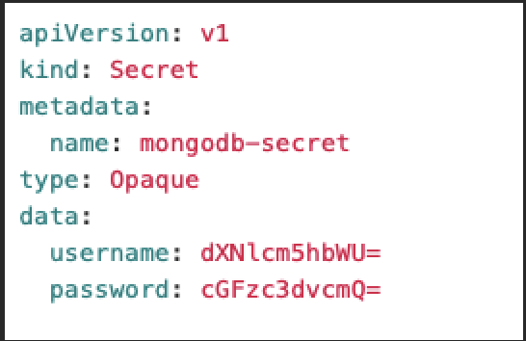

Slide 7
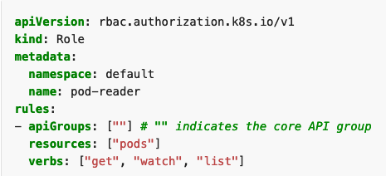
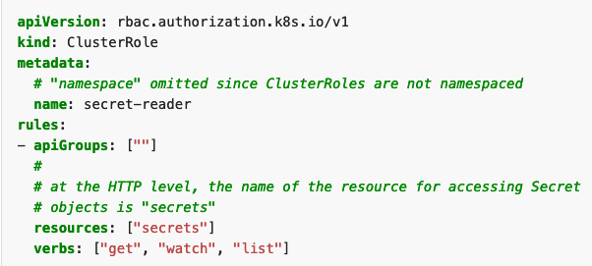
Role Based Access Control
Setting the permissions
Permissions are additive (no ”deny” rules)
A Role sets permissions within a particular namespace
A ClusterRole is non-namespaced and used to grant permissions cluster wide
Role Example
ClusterRole Example
Notes:
https://kubernetes.io/docs/reference/access-authn-authz/rbac/

Slide 8
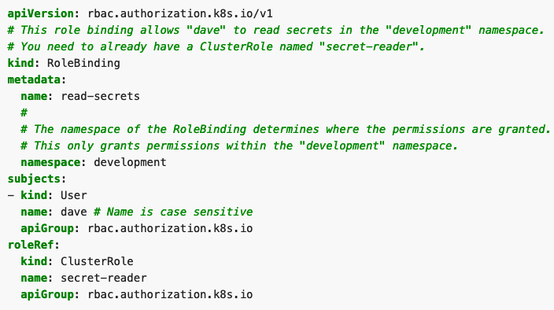
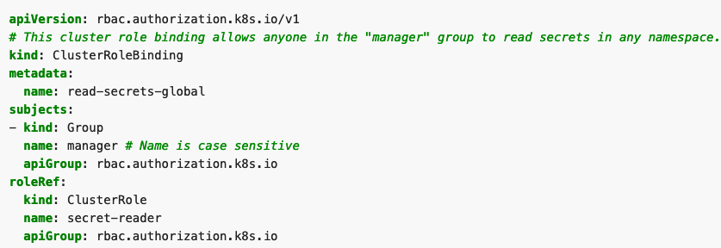
Role Based Access Control - continued
Binding the permissions
No identity management system “out of the box”
A role binding grants the permissions defined in a role to a user or set of users
A ClusterRoleBinding grants permission across a whole cluster
RoleBinding Example
ClusterRoleBinding Example
Notes:
https://kubernetes.io/docs/reference/access-authn-authz/rbac/

Slide 9
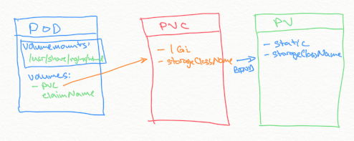
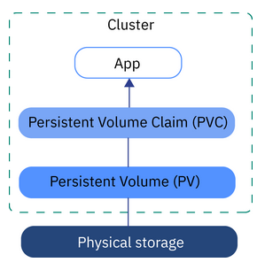
Persistent Volumes
Static Provisioning
Storage Class capabilities come from the CSI plugin used
For labs, we will use the “standard” storage class that comes by default in kind
Notes:
https://kubernetes.io/docs/concepts/storage/persistent-volumes/
https://kubernetes.io/docs/tasks/configure-pod-container/configure-persistent-volume-storage/

Slide 10
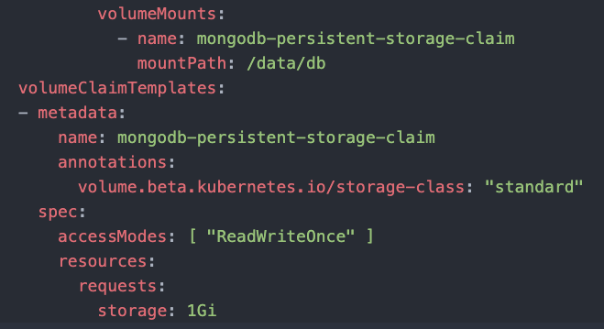
Persistent Volumes
Dynamic Provisioning
Use volumeClaimTemplates to allocate storage dynamically / “just in time”
The use case for this is when you have a statefulset with a variable # of replicas
Notes:
https://kubernetes.io/docs/concepts/storage/persistent-volumes/
https://kubernetes.io/docs/tasks/configure-pod-container/configure-persistent-volume-storage/

Slide 11
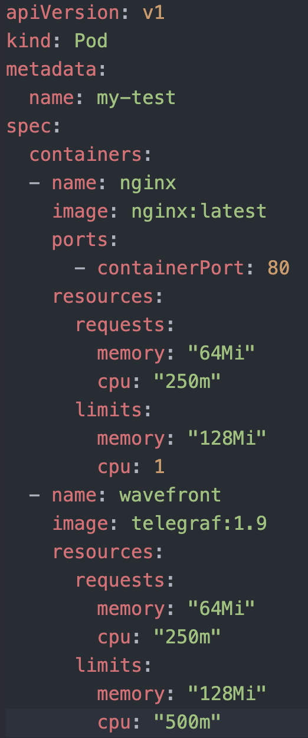
Resource Requests and Limits
Used to set pod cpu and memory resources
Requests are what the pod is allocated to begin with but can grow
Limits put a cap on growth (without limits, no cap)
One cpu, in Kubernetes, is equivalent to 1 vCPU/Core for cloud providers and 1 hyperthread on bare-metal
The Kubernetes resource scheduler will only schedule the pod if there are free resources. It will not overcommit.
If a Container exceeds its memory limit, it might be terminated. If it is re-startable, the kubelet will restart it, as with any other type of runtime failure. Look for “OOMkilled” if pod exceeds memory.
Notes:
https://kubernetes.io/docs/concepts/configuration/manage-resources-containers/
Memory exceeded example: https://kubernetes.io/docs/tasks/configure-pod-container/assign-memory-resource/

Slide 12
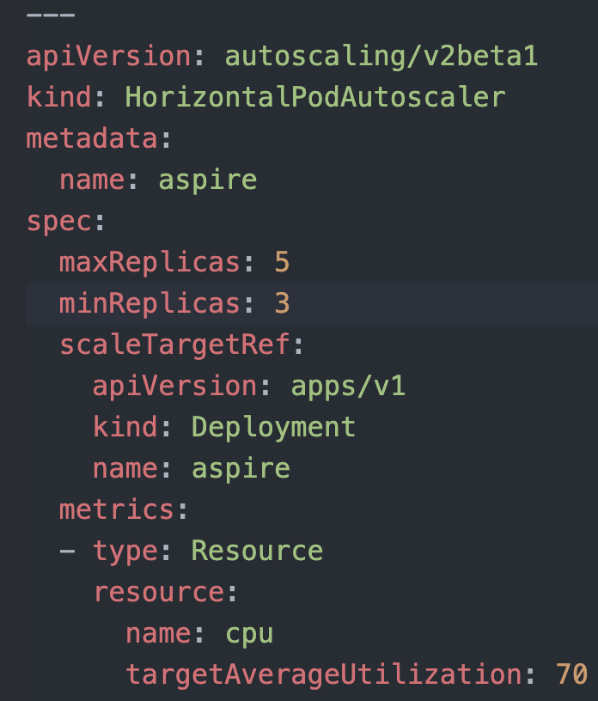
Horizontal Pod Autoscaler
Used to scale up the number of replicas
Automatically scales the number of Pods in a replication controller, deployment, replica set or stateful set based on observed CPU utilization
Lets pods scale past the replicas setting
Important: the pod should be “right sized” to begin with or this could aggravate resource waste
Notes:
https://kubernetes.io/docs/tasks/run-application/horizontal-pod-autoscale/

Slide 13
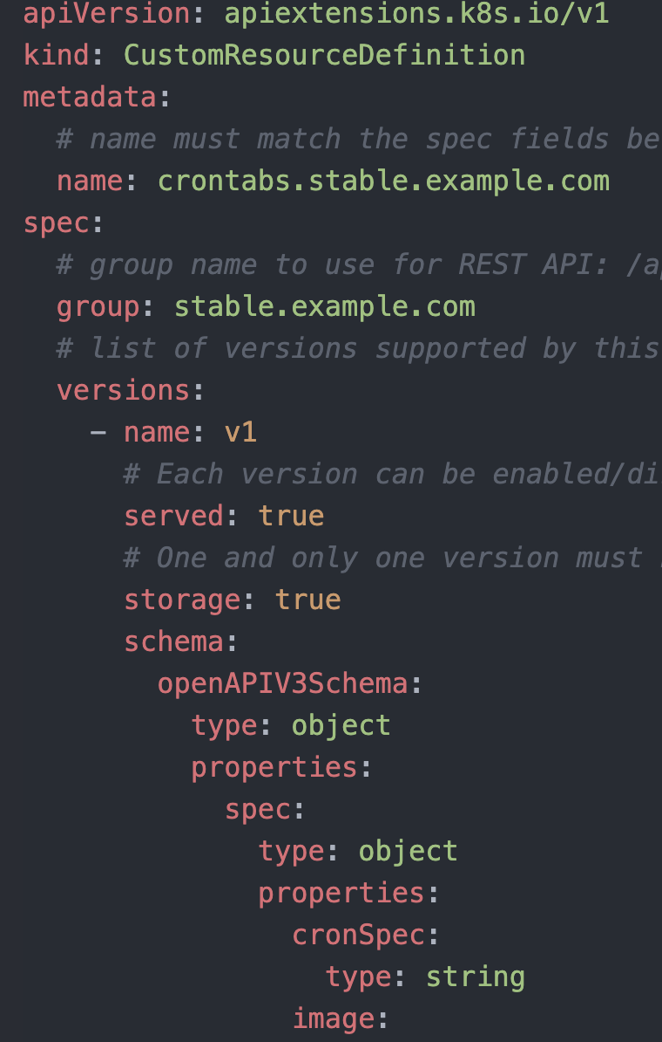
Custom Resource Definitions
Used to extend the Kubernetes API
Custom resources add new functionality to Kubernetes
The CRD can be namespace or cluster-scoped
Results in a new “kind:” that can be used
Each CRD results in a new REST API endpoint
See available resources with “kubectl api-resources”
Be aware that the required apiVersion may change with newer versions of K8s and can also result in different yaml code
Notes:
https://kubernetes.io/docs/tasks/extend-kubernetes/custom-resources/custom-resource-definitions/

Slide 14
Node Operations
How to cleanly shut a node down
Shutting a VM down cleanly does not translate to a K8s node – K8s does not automatically shut down if the OS is shut down.
Not draining the K8s nodes can lead to stuck pods that are unattached from their persistent disks
First step is to mark a node unschedulable. This prevents the scheduler from placing new pods onto that node but does not affect existing Pods on the Node.
kubectl cordon <node name>
Second step is to drain the node
kubectl drain <node name>
You may need to use force flags
Notes:
hhttps://kubernetes.io/docs/tasks/administer-cluster/safely-drain-node/

